Slide 1
Software Projects (IS52018C)
Software Quality

Slide 2
Software Quality
“Conformance to explicitly stated functional and performance requirements, explicitly documented standards, and implicit characteristics that are expected of all professionally developed software”
Pressman & Ince (2010)

Slide 3
Software Quality
• Typically define quality in terms of
measurable characteristics of software.
• Can be thought of in terms of...
• Quality of design
• Quality of conformance
• User-perceived quality
VIDEO: http://info.ibs-us.com/blog/bid/51517/The-Importance-of-Quality-Assurance-Top-3-Quality-Failures

Slide 4
Software Quality
Quality Assurance Quality Control
Managing development Measuring software
Ensure quality Provide feedback
Prevent defects Identify defects
Both essential for high quality software

Slide 5
Quality of Design
Quality of design refers to how well a
system was designed, i.e. grade of materials, tolerances and performance specifications.
In software development, quality of design
encompasses both requirements and design specification of the system.

Slide 6
Quality of Conformance
• Quality of conformance refers to how well the design specifications are followed during manufacturing.
• In software development, quality of conformance focuses on implementation. How well does it meet the requirements and design specification?

Slide 7
Quality & Users
• User-centred design includes user’s satisfaction and experience in concept quality.
• If the user is unhappy then other measures of quality aren’t going to matter much.
• DeMarco (1999):“A product’s quality is a
function of how much it changes the world for the better.”
• Users may overlook other quality problems if the software substantially benefits them.

Slide 8
Assurance vs Control
• Quality Assurance (QA) is about managing the development process to ensure quality. Focus on preventing errors.
• Quality Control (QC) is about measuring
quality during development to provide feedback. Focus on identifying errors.
• Both are essential for high quality software.

Slide 9
QA Planning
• Evaluations to be performed.
• Audits and reviews to be performed.
• Standard that are applicable to the project.
• Procedures for error report/tracking.
• Documents to be produced on quality.
• Amount of feedback to provide to
developers.

Slide 10
Quality Costs
• All costs incurred in the pursuit of quality.
• Prevention costs, e.g. planning, formal reviews, test equipment, training.
• Appraisal costs, e.g. inspection, testing,
equipment maintenance
• Internal failure costs, e.g. rework, repair,
failure mode analysis.
• External failure costs, e.g. complaint
resolution, product return/replacement, help line support, warranty work.

Slide 11
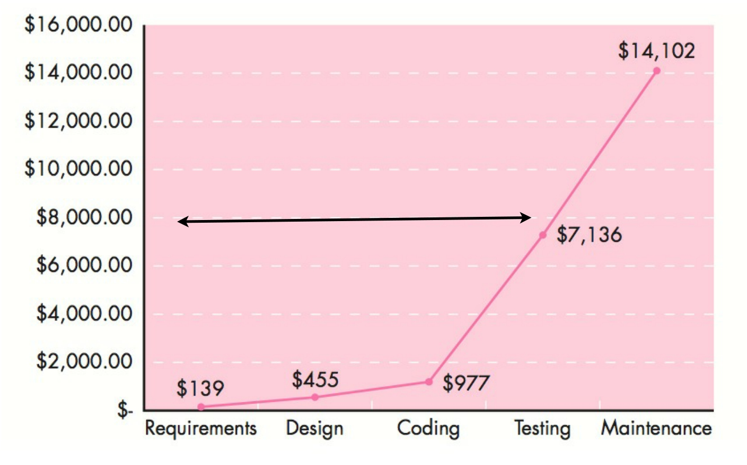
Cost Per Fix
Defect
Errors
From Pressman (2010), adapted from Boehm & Basili (2001).

Slide 12
Errors & Defects
IBM Case Study by Kaplan et al. (1995)
• System with 200k lines of code
• Prevent errors: Takes programmer 7053
hours to find 3112 errors at $40/hr. Total cost is
$282k or $91/error.
• Fix defects: Assume 1 in 1000 lines of code
has notable defect, so 200 defects. Costs IBM
$25k per fix. Total cost is $5 million.
• 18 times more expensive to fix after release.

Slide 13
Software Reviews
• Reviews act as a filter during the
development process: repeatedly applied to remove errors.
• Why review in groups?
• Everybody makes mistakes.
• Some mistakes are very hard to spot
for the person that made them.

Slide 14
Software Reviews
“Any review is a way of using the diversity of a
group of people to:
• Point out needed improvements in the product
of a single person or team.
• Confirm those parts of a product in which
improvement is either not desired or not needed.
• Achieve technical work of a more uniform, or at
least more predictable, quality than can be achieved without reviews.”
Freeman & Weinberg (1990)

Slide 15
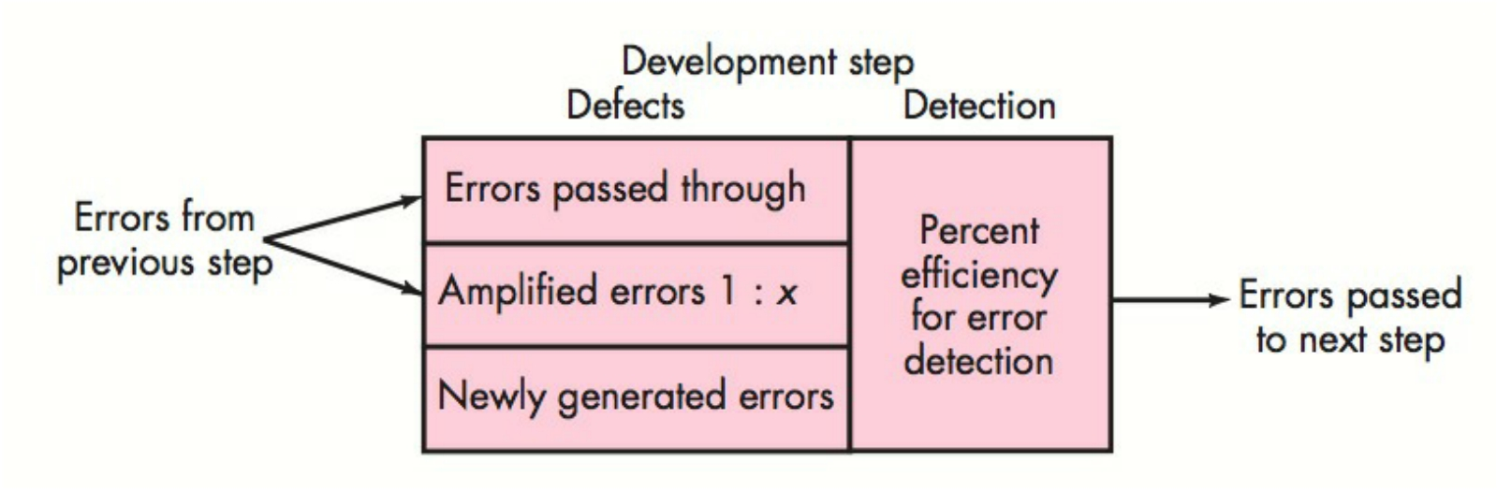
Defect Amplification Model
Each development step adds new errors
and amplifies some old ones.

Slide 16
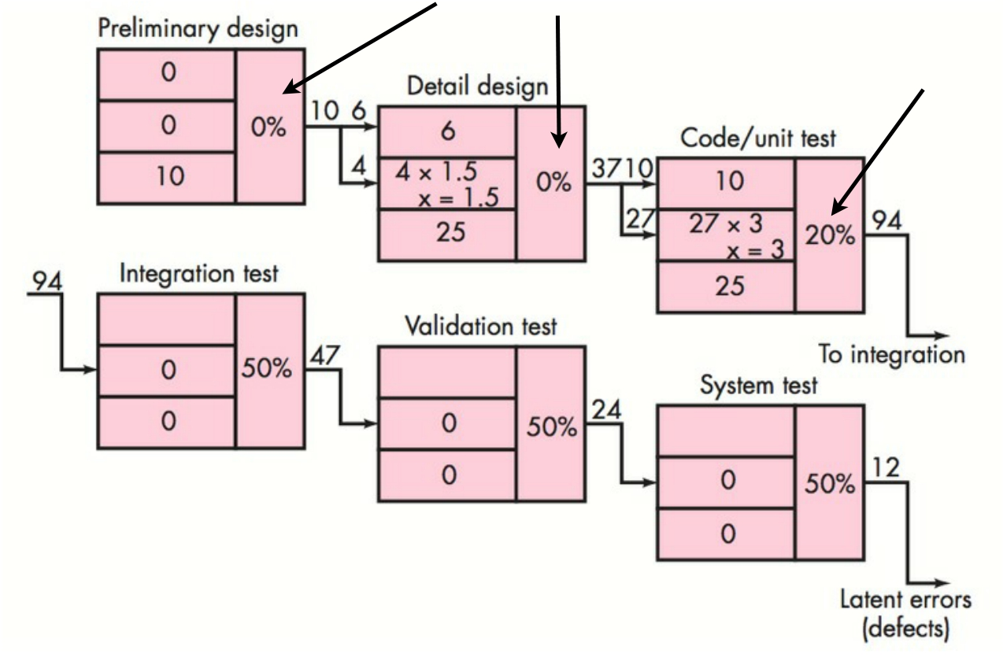
Defect Amplification (without software reviews)
No errors caught during design
Few errors caught during coding
From Pressman (2010)

Slide 17
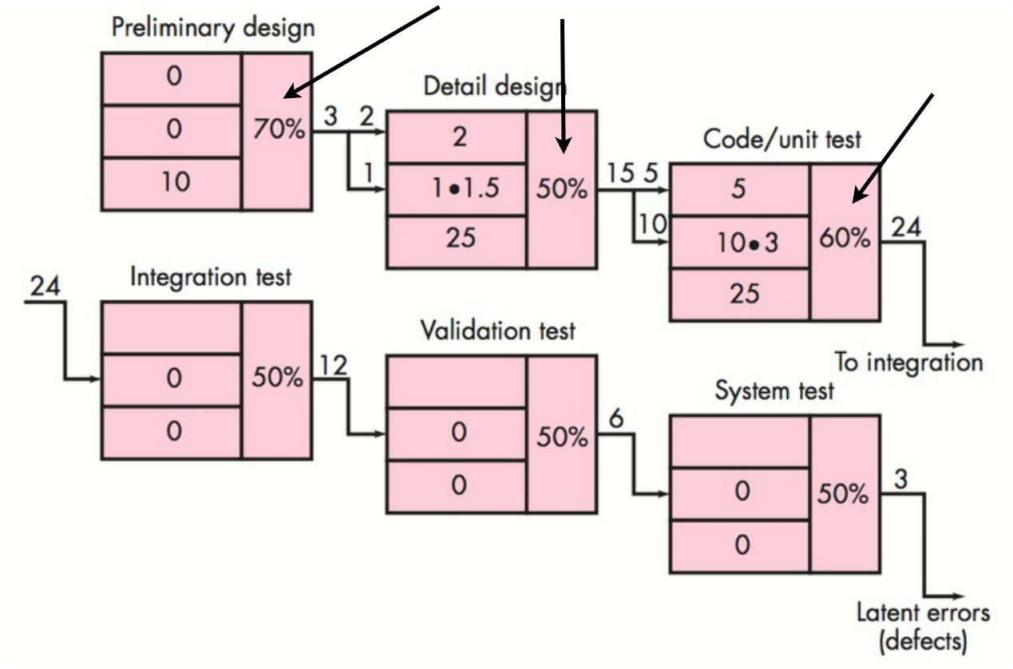
(with software reviews)
Reviews catch design errors
More errors caught during coding
From Pressman (2010)

Slide 18
Formal Technical Reviews
• Conducted by software engineers
• To find errors early on so that they don’t
propagate and become defects.
• Verify software meets requirements.
• Help manage development process.
• Allow communication between different parts
of development team, and train new members.

Slide 19
Formal Technical Reviews
Walkthroughs
• Walkthrough reviews focus on specific part of overall software, a work product
• Could be a subset of requirements, design
or source code for a component etc.
• 3-5 reviewers
• Prepare in advance: each reviewer
familiarises themselves with the work product, makes notes on errors.

Slide 20
Formal Technical Reviews
Walkthroughs
• The producer walks through the work product they created (e.g. line by line of code).
• Reviewers raise their issues at each step.
• One reviewer acts as a recorder, noting down each
valid error when discovered.
• Finally, reviewers decide outcome:
1. Accept without further modifications
2. Reject due to severe errors (fix then rereview)
3. Provisionally accept minor errors (just fix)

Slide 21
Formal Technical Reviews
Walkthroughs
• A review leader needs to...
• Chair meeting: set agenda, limit debate,
avoid drift, finalise decisions/actions.
• Produce an issue list: errors found and
actions required.
• Review the product not the producer.

Slide 22
Statistical Software QA
• May not have resources to correct all errors.
• Categorising errors according to their
underlying causes provides statistical data to manage QA.
• Pareto Principle: 80% of the effects come
from 20% of the causes.
• Identify that 20% (“the vital few”) and correct
those problems.

Slide 23
Statistical Software QA
Example Error Analysis
1. Incomplete or erroneous specifications (IES)
2. Misinterpretation of customer communication (MCC)
3. Intentional deviation from specifications (IDS)
4. Violation of programming standards (VPS)
5. Error in data representation (EDR)
6. Inconsistent component interface (ICI)
7. Error in digital logic (EDL)
8. Incomplete or erroneous testing (IET)
9. Incomplete or incomplete documentation (IID)
10. Error in programming language translation or design (PLT)
11. Ambiguous or inconsistent human computer interface (HCI)
12. Miscellaneous (MIS)

Slide 24





Error | Serious | Moderate | Minor | Total
IES | 34 | 68 | 103 | 205
MCC | 12 | 68 | 76 | 156
IDS | 1 | 24 | 23 | 48
VPS | 0 | 15 | 10 | 25
EDR | 26 | 68 | 36 | 130
ICI | 9 | 18 | 31 | 58
EDL | 14 | 12 | 19 | 45
IET | 12 | 35 | 48 | 95
IID | 2 | 20 | 14 | 36
PLT | 15 | 19 | 26 | 60
HCI | 3 | 17 | 8 | 28
MIS | 0 | 15 | 41 | 56
TOTAL | 128 | 379 | 435 | 942

Slide 25
Error | Serious | Moderate | Minor | Total
IES | 34 | 68 | 103 | 205
MCC | 12 | 68 | 76 | 156
IDS | 1 | 24 | 23 | 48
VPS | 0 | 15 | 10 | 25
EDR | 26 | 68 | 36 | 130
ICI | 9 | 18 | 31 | 58
EDL | 14 | 12 | 19 | 45
IET | 12 | 35 | 48 | 95
IID | 2 | 20 | 14 | 36
PLT | 15 | 19 | 26 | 60
HCI | 3 | 17 | 8 | 28
MIS | 0 | 15 | 41 | 56
TOTAL | 128 | 379 | 435 | 942
Three categories
responsible for
53% of errors

Slide 26
Error | Serious | Moderate | Minor | Total
IES | 34 | 68 | 103 | 205
MCC | 12 | 68 | 76 | 156
IDS | 1 | 24 | 23 | 48
VPS | 0 | 15 | 10 | 25
EDR | 26 | 68 | 36 | 130
ICI | 9 | 18 | 31 | 58
EDL | 14 | 12 | 19 | 45
IET | 12 | 35 | 48 | 95
IID | 2 | 20 | 14 | 36
PLT | 15 | 19 | 26 | 60
HCI | 3 | 17 | 8 | 28
MIS | 0 | 15 | 41 | 56
TOTAL | 128 | 379 | 435 | 942
Four categories responsible for 70% of serious
errors
Spend resources
on fixing these!

Slide 27
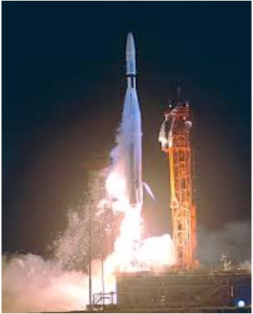
History’s Worst Bugs
They should have tested properly...
1. Mariner 1 space probe (exploded)!
2. Ariane 5 flight 501 (exploded)!
3. Trans-Siberian gas pipeline (exploded)!
4. Therac-25 medical accelerator (killed 5+)!
5. Multidata radition dose planner (killed 8+)!
6. Berkeley Unix finger daemon (1st internet worm)!
7. Keberos random number generator (not random)!
8. AT&T telephone switches (crashs affect ~60k people)!
9. Intel Pentium chip FP division ($475m to replace)!
10. TCP/IP implementations (allow “ping of death”)!
http://archive.wired.com/software/coolapps/news/2005/11/69355
https://www.quora.com/What-is-the-worst-programming-bug-in-history

Slide 28
Verification & Validation
• Verification: are we building the software
right? Does it correctly implement a specific function?!
• Validation: are we building the right
software? Does this software fulfil the stated requirements?!
• Testing can be used for both.

Slide 29
Further Reading
• Pressman & Ince, Chapter 8.
• Pressman’s website on QA
http://www.rspa.com/spi/SQA.html

